Slide 1




REAL-TIME DRIVER DROWSINESS
DETECTION SYSTEM
TEAM MEMBERS:
Divya C -
Mirdula S -
811721243015
811721243028
GUIDE NAME
Swetha S - 811721243056
SriAshika M- 811721243304
Mr. Joshua Issac Assistant Professor (AI)

Slide 2
OBJECTIVE
Ensure driver’s safety
Prevents accidents due to drowsiness
Real-Time Monitoring
Timely Alerts

Slide 3
PROBLEM DEFINITION
EXISTING SYSTEM:
Detects drowsiness but doesn’t alert driver
PROPOSED SYSTEM:
Real time drowsiness of driver’s causing accidents and deaths
Especially in distance travelling
Water sprinkler activation
Timely alerts

Slide 4
 |  | LITERA |  | RVEY
 | S.NO | Title | Author & Year | Technique used | Demerits
 | 1. | Privacy Preserving Federated Transfer Learning for Driver | Linlin Zhang, (20 July 2022) | Transfer learning, federated learning | Communication Overhead , Security
 |  | Drowsiness Detection |  |  | Concerns, Heterogeneous Data
 | 2. | Driver Drowsiness Detection | Chao Zhang, | Blood volume | Data Collection
 |  | Using Multi-Channel Second | January 10, | pulse (BVP), | Challenges,
 |  | Order Blind Identifications | 2019 | Drowsiness | Generalization,
 |  |  |  | detection, Second- | Ethical
 |  |  |  | order Blind | Considerations
 |  |  |  | identification
 |  |  |  | (SOBI).

Slide 5
Title
S.NO
Author & Year
Technique used
Demerits
Real Time Drowsiness Detection System For Driver Monitoring
M.MohanaDeept hi, K.Rani., J.Angel Pearl Veronica.
July 7, 2021
Machine Learning,Water Sprinkler Activation
Privacy concerns, Power consumption
,Driver Variability
3.
4.
Real-Time Driver-Drowsiness Detection System Using Facial Features
Wanghua Deng and Rouxue wu August 21, 2019
Convolutional neural network, fatigue detection, feature location, face tracking.
Environmental Factors, Hardware Requirements

Slide 6
S.NO
Title
Author & Year
Technique used
Demerits
Detecting Human Driver Inattentive and Aggressive Driving Behavior Using Deep Learning: Recent Advances, Requirements and Open Challenges
Monagi H . Alkinani and Wazir Zada Khan
Deep learning, human inattentive driving behavior, abnormal behavior detection,
Resource Intensive, Generalization to Unseen Scenarios
5.

Slide 7
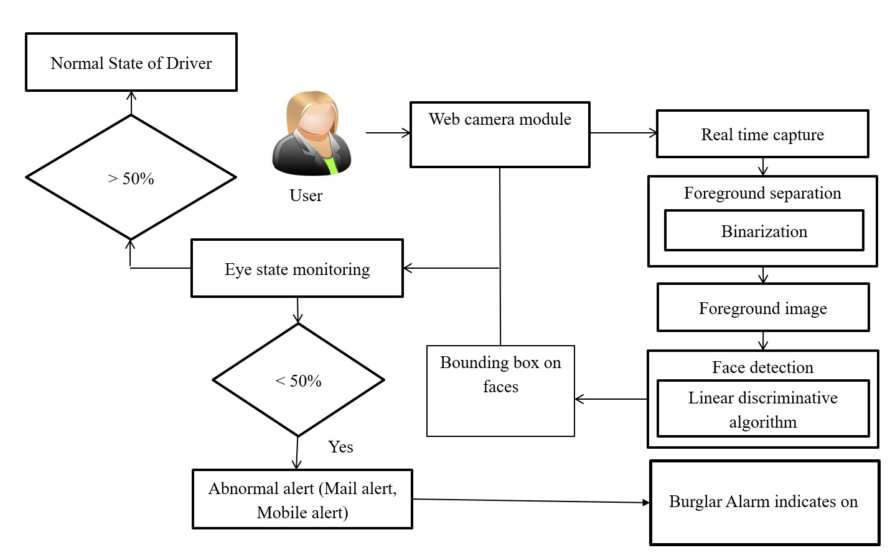
ARCHITECTURE DIAGRAM
CNN Algorithm
Water sprinkler activation

Slide 8
SYSTEM SPECIFICATIONS
HARDWARE SYSTEM CONFIGURATION
Computer - minimum of 4GB RAM & dual-core processor.
Webcam - at least 720p & high frame rate of at least 30fps.
Stable internet connection.
Storage
SOFTWARE SYSTEM CONFIGURATION
Python programming language - Python serves as the primary programming language
Operating system - Windows, macOS, Linux distributions
Python libraries - OpenCV, D lib, TensorFlow
HTML/CSS or JavaScript - for UI design.

Slide 9
MODULES
Image Processing Module
Drowsiness Detection Module
Decision- Making Module
Water Sprinkler Module
Alerting Module

Slide 10
IMAGE PROCESSING MODULE
Face Detection: The module first identifies and locates the face within the image or video frame. It uses techniques like deep learning-based methods such as CNNs.
Facial Landmark Detection: Once the face is detected, the system locates key facial landmarks like eyes, nose, and mouth. These landmarks serve as reference points for further analysis.
Eye State Analysis: The module analyzes the state of the eyes, looking for indicators of
drowsiness such as eyelid closure or slow blinking.
Head Pose Estimation: Determining the orientation of the head can provide additional
context for assessing drowsiness.

Slide 11
DROWSINESS DETECTION MODULE
Sensor Integration: Utilizes cameras and sensors to monitor driver's eye movements, blink rate, and head position.
Data Processing:Employs algorithms to analyze sensor data and identify signs of
drowsiness, such as prolonged eye closure or erratic driving patterns.
Real-Time Monitoring: Continuously tracks the driver's alertness levels, updating the
system with real-time information.
Threshold-Based Alerts: Triggers alerts when specific drowsiness thresholds are met, indicating potential driver fatigue.

Slide 12
DECISION MAKING MODULE
Data Analysis: Aggregates input from the drowsiness detection module.
Risk Assessment: Evaluates the severity of detected drowsiness and potential risks to
driving safety.
Response Strategy: Determines the most appropriate response, such as issuing warnings.
Adaptive Learning: Utilizes machine learning to improve decision-making accuracy based on past incidents and driver behavior.

Slide 13
ALERTING MODULE
Auditory Alerts: Loud beeping sounds or voice notifications to immediately capture the driver’s attention.
Drowsiness Detection: When signs of fatigue are detected, the alerting module is
activated.
Escalation Protocol: Increases the intensity of alerts if the driver does not respond to
initial warnings.
Monitoring: The system continuously monitors the driver’s state using cameras or sensors.

Slide 14
WATER SPRINKLER MODULE
Water Sprinkler Mechanism: A small, strategically placed device capable of spraying a fine mist of water onto the driver’s face when drowsiness is detected.
Control Unit: Processes signals from the detection system and activates the sprinkler
when thresholds for drowsiness are exceeded.
Water Reservoir: A compact, refillable container holding the water for the sprinkler.
Nozzle and Spray Pattern: Designed to ensure even and effective dispersion of water without causing discomfort or distraction.

Slide 15
ADVANTAGES
Enhanced Public Safety
Promotes responsible driving
Real Time Implementation
Can be applied in other domains

Slide 16
APPLICATIONS
Commercial Vehicles
Passenger Vehicles
Public Transportation
Emergency Vehicles

Slide 17
CONCLUSION
The drivers state of alertness monitoring through the identification of the fight
against to fall asleep has been proposed.
The obtained quality signal level has been combined with the drowsiness detection algorithm.
In future,wearable devices such as smart watches or other devices can be used to identify parameters like pulse rate, heart rate, BP etc to detect drowsiness more accurately and efficiently.

Slide 18
REFERENCE
Drowsy driving and automobile crashes, Nat. Center Sleep Disorders Res./Nat. Highway Traffic Saf.Admin.Expert Panel Driver Fatigue Sleepiness, Tech. Rep. DOT- HS-808-707, 1998, vol. 808, p. 707.
P. Jackson, C. Hilditch, A. Holmes, N. Reed, N. Merat, and L. Smith, Fatigue and Road Safety: A Critical Analysis of Recent Evidence. London, U.K.: Department of Transport, 2011, no. 21.
Y. Ed-Doughmi, N. Idrissi, and Y. Hbali,“Real-time system for driver fatiguedetection based on a recurrent neuronalnetwork,” Journal of Imaging, vol. 6, no.3, p. 8, 2020.

Slide 19
THANK YOU

